Slide 1


C-Language Project
Magic Tower

Slide 2
Task Assignment
Huang Linzhi
Chen Guangxing
Zhang Xiaowen
Project structure analysis Algorithm transformation
Map matrix preparation and implementation
Optimization of the project
Operation time reduced

Slide 3

目录
CHUANGYI SHOUHUI
1. Problem statement
2. Analysis &Design
3. Implementation（debug）
4. Test

Slide 4
Problem Statement&
Analyse
Notes:
Riddle & RPG Game

Slide 5
Magic Tower
As an RPG strategy game, "magic tower" game was started in 2005. It has been fine-tuned several times. Revised to version 1.12.
We expect to use C language to restore its function and realize its basic function operation, at the same time, we will add our own innovation (such as new map).

Slide 6
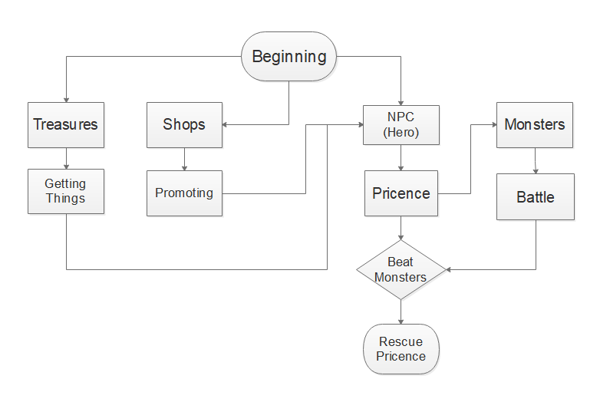
Basic Logic

Slide 7
Problem statement
MICROSOFT POWERPOINT MY 2017
Magic tools
Monster
Success determination
use the way to solve the calculate
problem
finish the final task(defeat the boss)
how to show the special use

Slide 8
Design

Slide 9
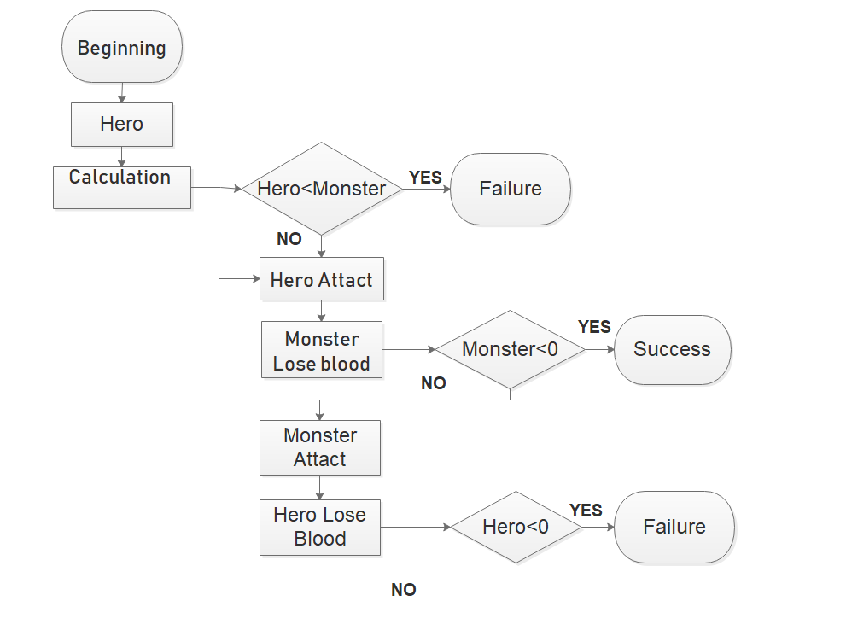
Fighting part

Slide 10
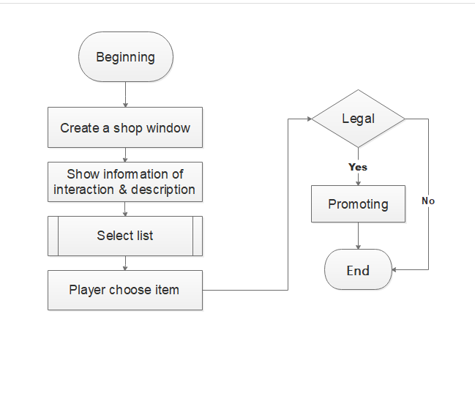
Shop part

Slide 11
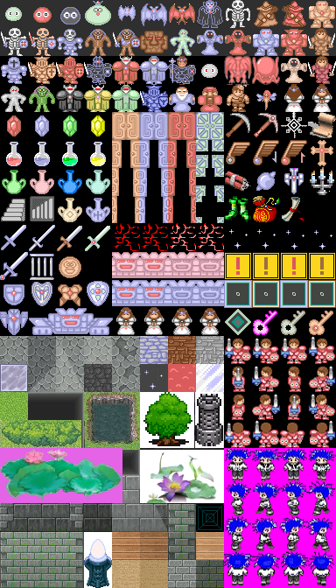
Design Principles
Reasonable route to upstairs
Suitable monster distribution
Flexible key turnover

Slide 12

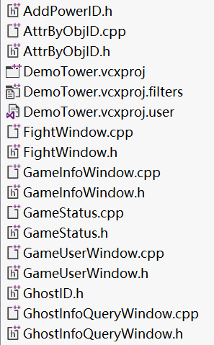
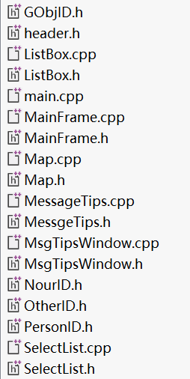
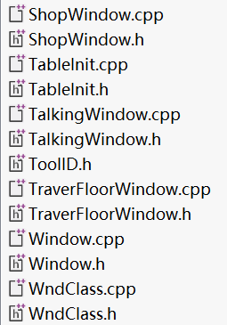
Functions

Slide 13
Main Function
Define all window areas of the game:
①Player action zone
②Game information area
Main Function

Slide 14
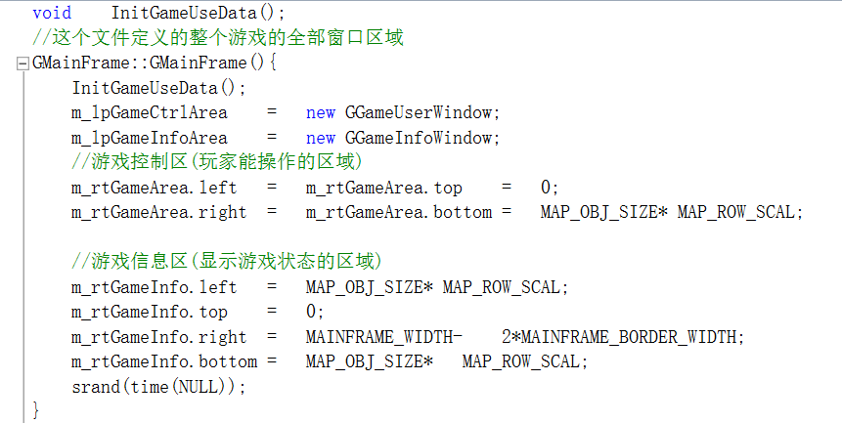
Main Function

Slide 15
What have we designed?
MICROSOFT POWERPOINT MY 2017
The balance of the game
Map，written by ourself,
A better UI
will also make players pleased
Beside fighting with monsters…
something else?

Slide 16
Implementation

Slide 17
Problems Encountered
Interaction Problem：
How to proceed Human-Computer interaction
Like shopping or communicate with NPC

Slide 18
Simple way to solve
1 make sure the hero is near our NPC
“near” ‘s mean
2special way to communicate .

Slide 19
Game Content

Slide 20
Contents
1. Maps written by matrices
2. Operator Interface (window)
3. Links between floors (upper and lower floors)
4. Props (blood plus & attack & complex props)
5. Optional list
6. Character parameters and monster parameters
7. Parameter algorithms (loops and subtraction)
8. PvP Interface (demo version mainly related to
its emergence and disappearance)
9. Links (how the Monster picture appears)

Slide 21
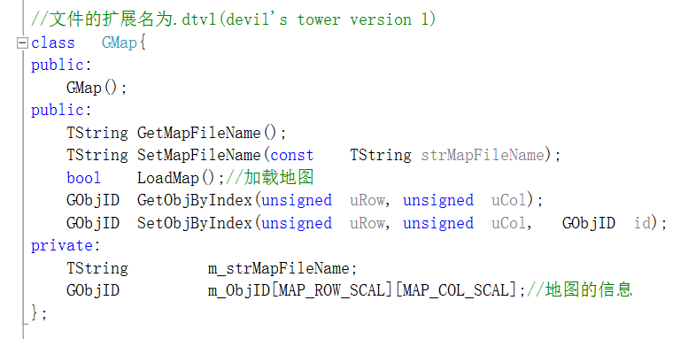
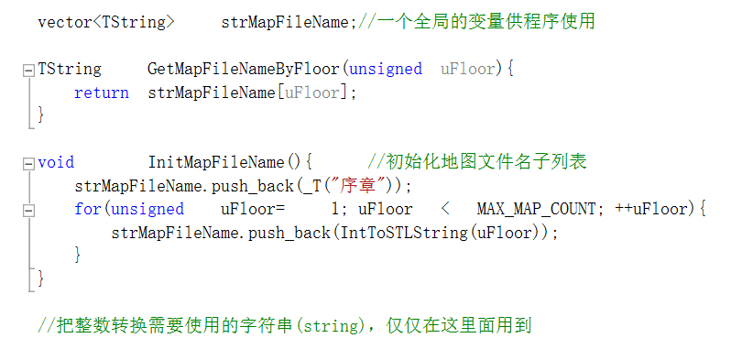
Maps

Slide 22
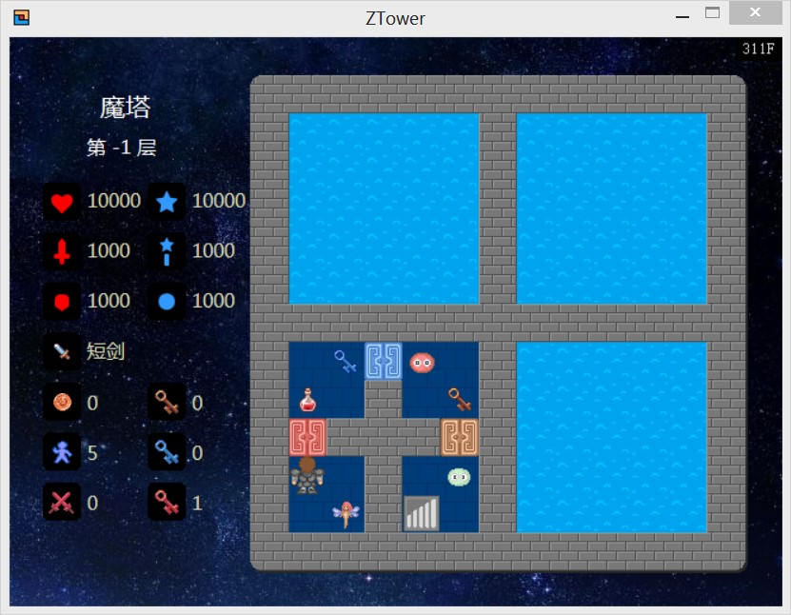
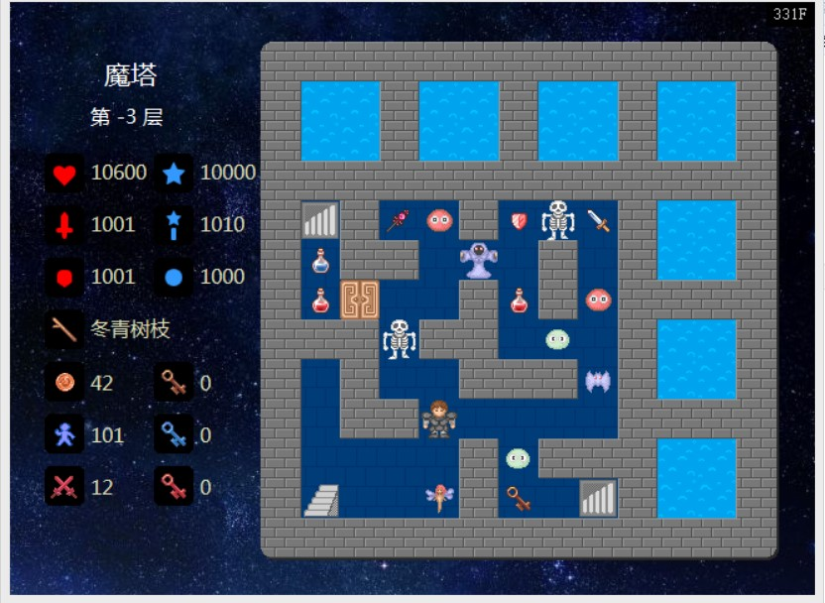
Windows\Links\props\Characters

Slide 23
THANKS!
CHUANGYI SHOUHUI SHANGWU MICROSOFT POWERPOINT MY 2017

